Slide 1
HARDWARE FUNDAMENTALS
Team 2
Aishwarya
Akanksha Mishra
Kimaya vartak
Letitia lyndsy
Nishigandha Parkhe
Vinay sagar

Slide 2
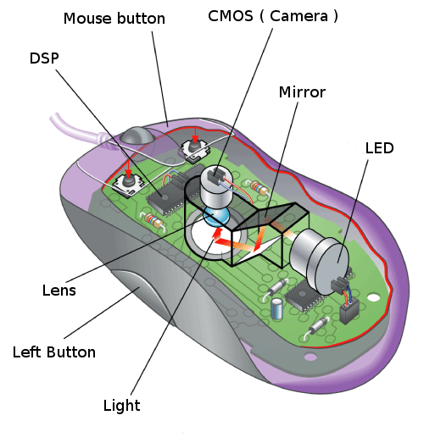
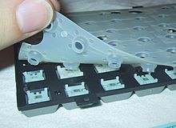

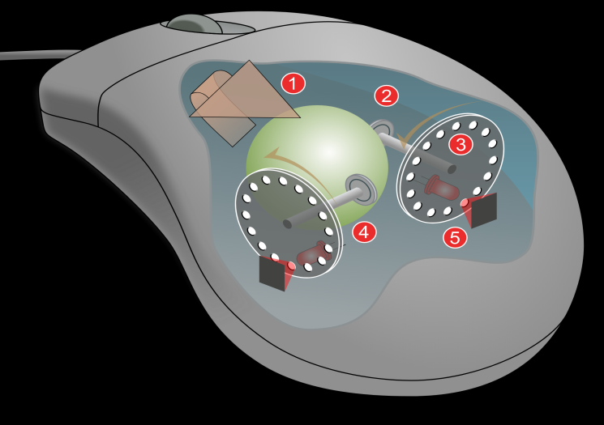
KEYBOARD AND MOUSE
MEMBRANE KEYBOARD
OPTICAL MOUSE
MECHANICAL KEYBOARD
MECHANICAL MOUSE

Slide 3
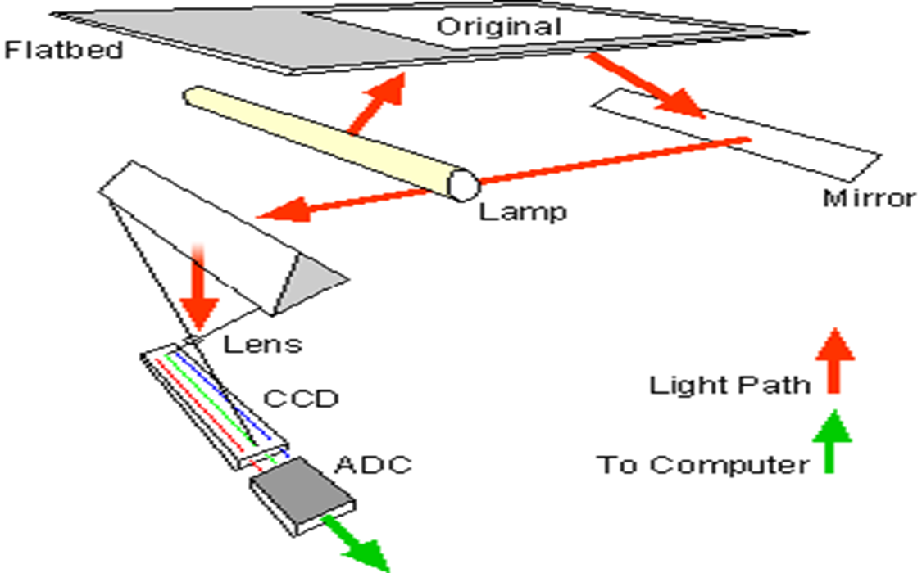
SCANNER

Slide 4
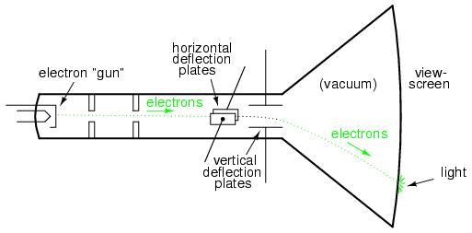
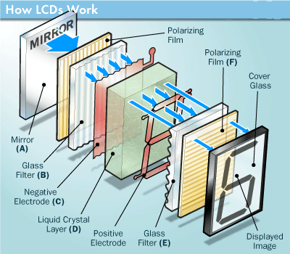
MONITOR
CRT
LCD

Slide 5
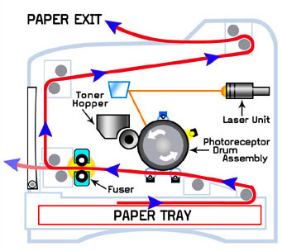
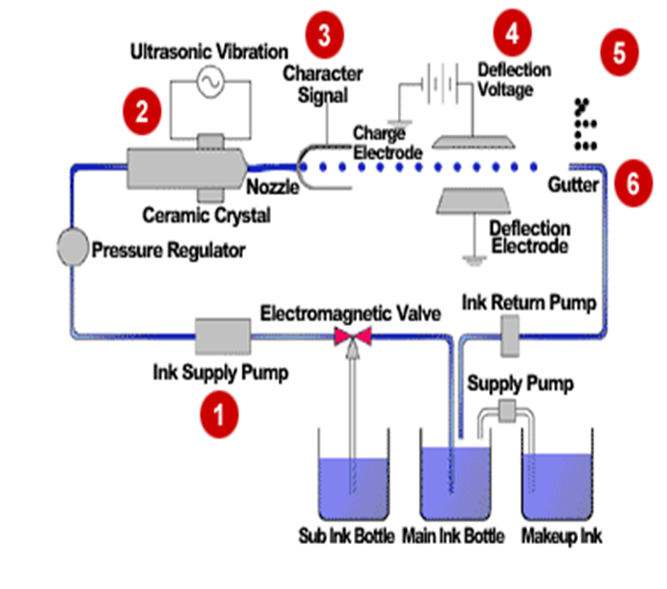
LASER PRINTER AND INKJET PRINTER

Slide 6
SMPS (SWITCHED MODE POWER SUPPLY)
AC INPUT
STEP DOWN TRANSFORMER
BRIDGE RECTIFIER
FILTER
VOLTAGE REGULATOR
DC INPUT
FEEDBACK

Slide 7
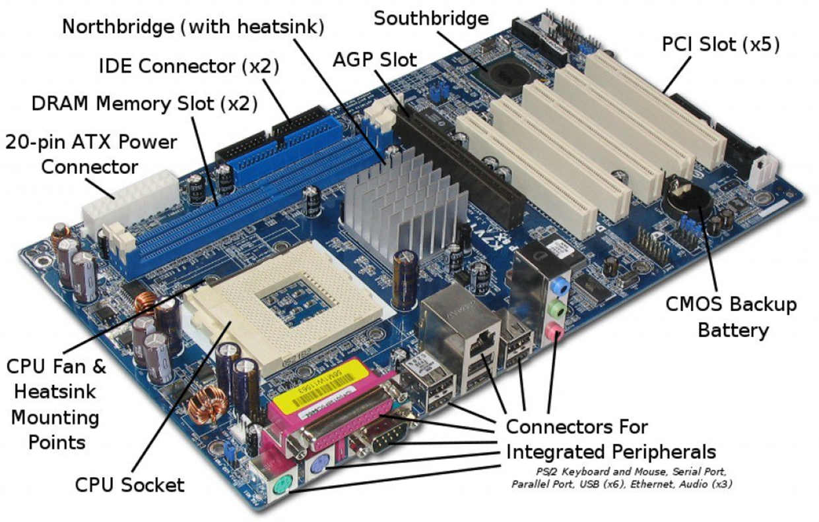
MOTHERBOARD

Slide 8
MEMORY
MEMORY
ROM
RAM
PROM
SRAM
EPROM
DRAM
EEPROM

Slide 9
Fundamentals of Windows

Slide 10
Operating System
User 1
User 2
User n
Types of OS
Network OS
Real time OS
Distributed OS
Multi-tasking OS
System Software
Application Software
Software
Operating System
Hardware
CPU
RAM
I/O

Slide 11
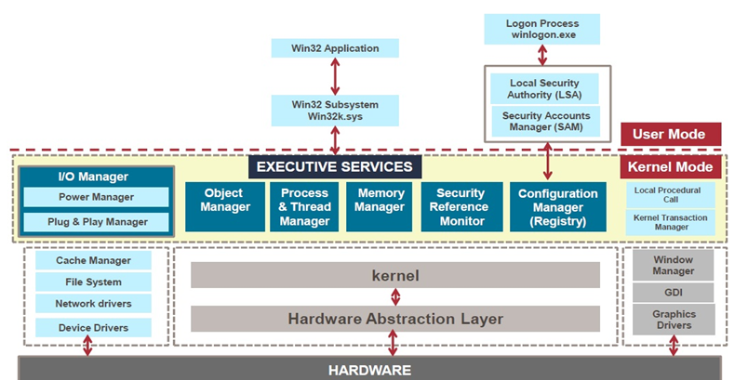
Kernel Architecture

Slide 12
Windows Booting Process
SMPS
BIOS
MBR
Boot Manager
Boot loader
winload.exe
wininit.exe
Client Server Runtime
Session Manager
ntoskrnl.exe
winlogon.exe
dwm.exe
explorer.exe

Slide 13
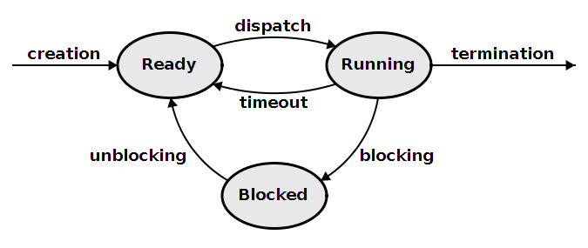
Process Management

Slide 14
FILE SYSTEM
BOOT LOADER | RESERVED SECTOR | FAT 1 | FAT 2 (DUPLICATE) | ROOT FOLDER | OTHER FILES
FAT File Structure
NTFS BOOT SECTOR | MASTER FILE TABLE | FILE SYSTEM DATA | MASTER FILE TABLE COPY
NTFS File Structure

Slide 15
Fundamentals of Linux

Slide 16

Linux
Linux is a generic term referring to Unix like graphical user interface (GUI) based computer operating systems.
It is Multi-user, Multitasking, Multiprocessor
Runs on multiple platforms
Includes the Source Code
Open Source Software

Slide 17
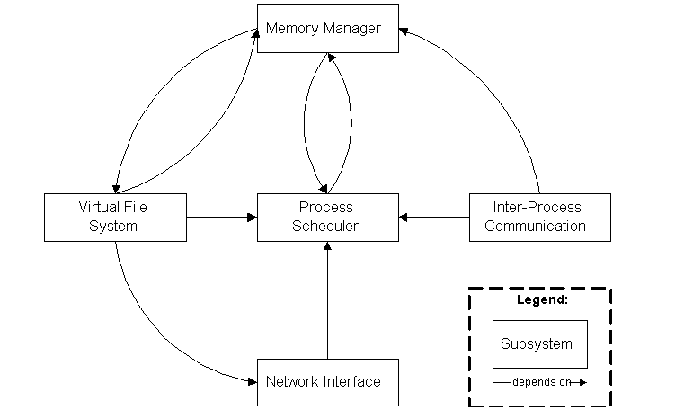
LINUX KERNEL SUBSYSTEM

Slide 18
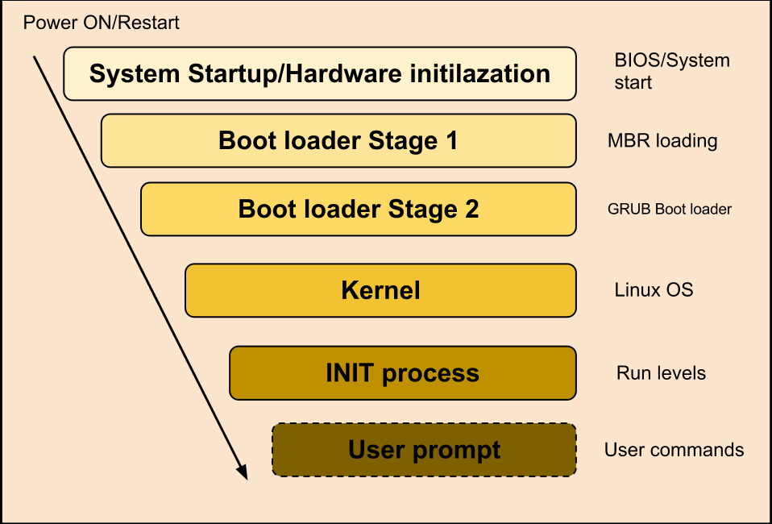
LINUX BOOTING PROCESS

Slide 19
UNIX FILE SYSTEM
BOOT BLOCK | SUPER BLOCK | INODE LIST | DATA BLOCK
EXT
EXT2 : It has Concept of Blocks, Inode and Directory
EXT3 : Journaling
EXT4 : Bigger File system, Multi-block allocation Journaling

Slide 20
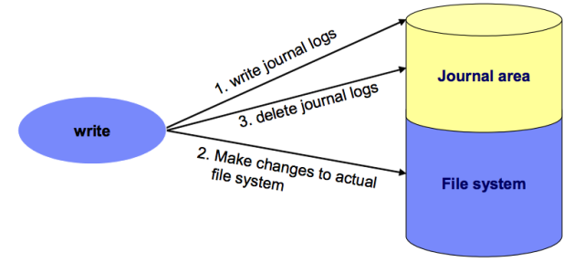
JOURNALING FILE SYSTEM
Ordered
Write Back
Data

Slide 21
PROCESS MANAGEMENT
PROCESS:
Zombie Process
Init
Parent Process
Child Process
Interactive Process
Batch or Automatic Process
Real-time Process
PROCESS SCHEDULING
FIFO
Round Robin
Shortest Job First
Priority based

Slide 22
Fundamentals of Networking

Slide 23
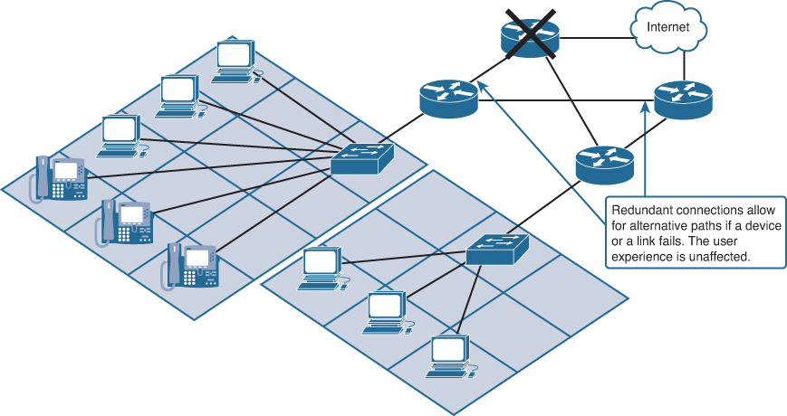
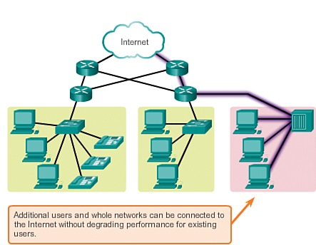
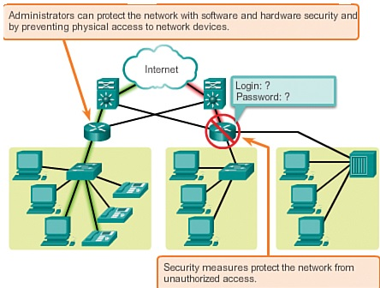
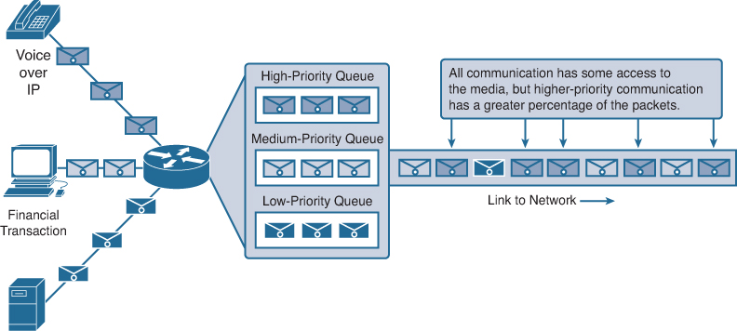
Networking
Fault tolerance
Scalability
Security
Quality of service

Slide 24
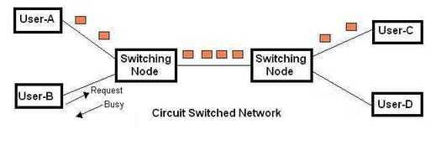
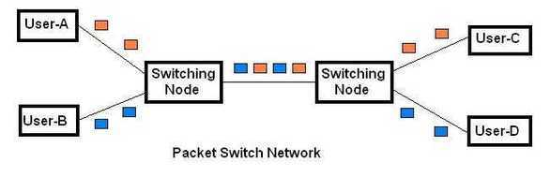
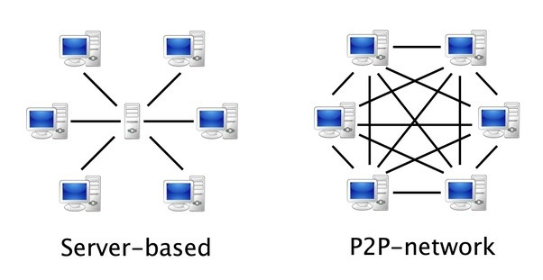
Circuit Switching and Packet Switching
Client/server and P2P Networking

Slide 25
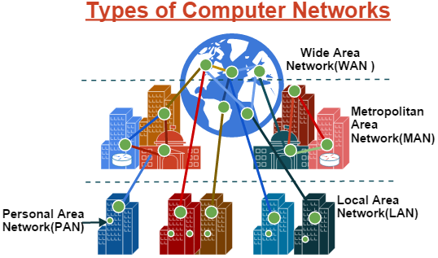
Types of Networks

Slide 26
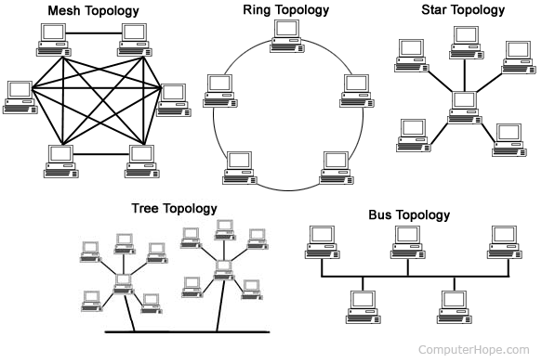
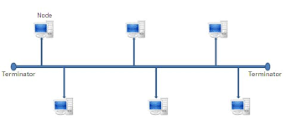
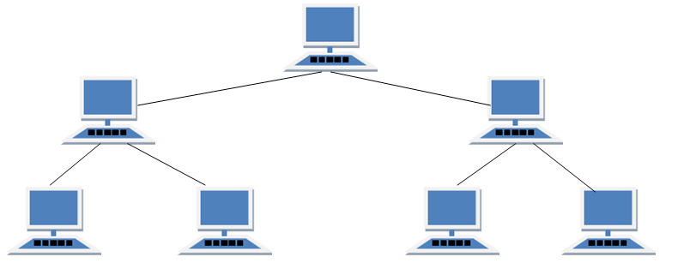
Network Topology
Tree Topology Bus topology

Slide 27
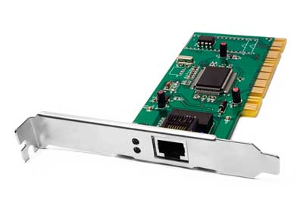
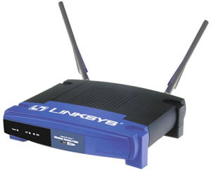
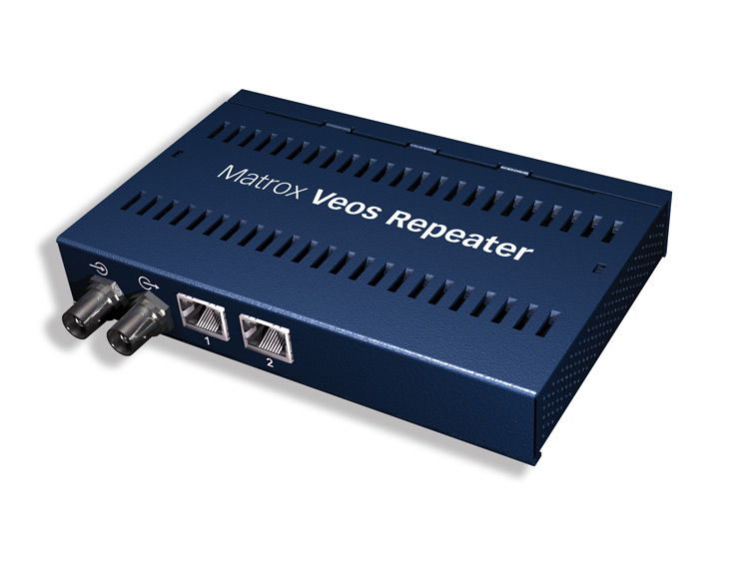
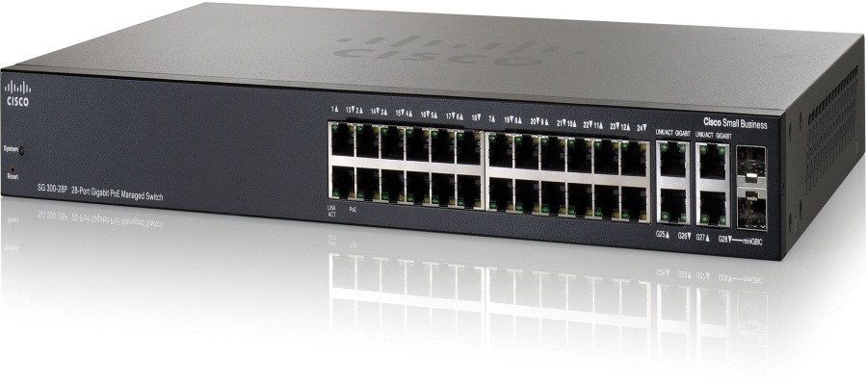
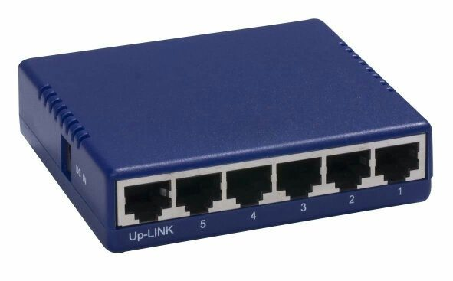
NETWORKING DEVICES
NIC CARD
ROUTER
REPEATER
SWITCH
HUB

Slide 28
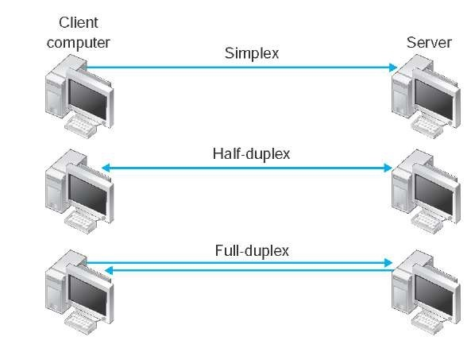
Network Terminologies

Slide 29
IP ADDRESS
32 bits
Network
Host
Class A
CLASS A
0-126
CLASSES OF IP ADDRESS
CLASS
B
128-191
CLASS
C
192-223
CLASS
E
240-255
CLASS
D
224-239
8 bits
24 bits
Class B
Network
Host
16 bits
16 bits
Class C
Network
Host
24 bits
8 bits

Slide 30
SUBNETTING
Subnetting is the strategy used to partition a single physical network into more than one smaller logical sub-networks (subnets)
Subnet Mask
A Subnet mask is a 32-bit number that masks an IP address, and divides the IP address into network address and host address. Subnet Mask is made by setting network bits to all "1"s and setting host bits to all "0"s.

Slide 31
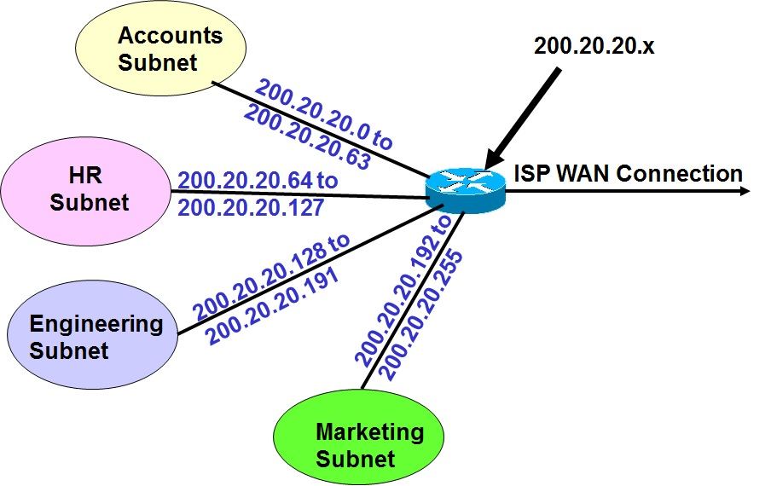

Slide 32
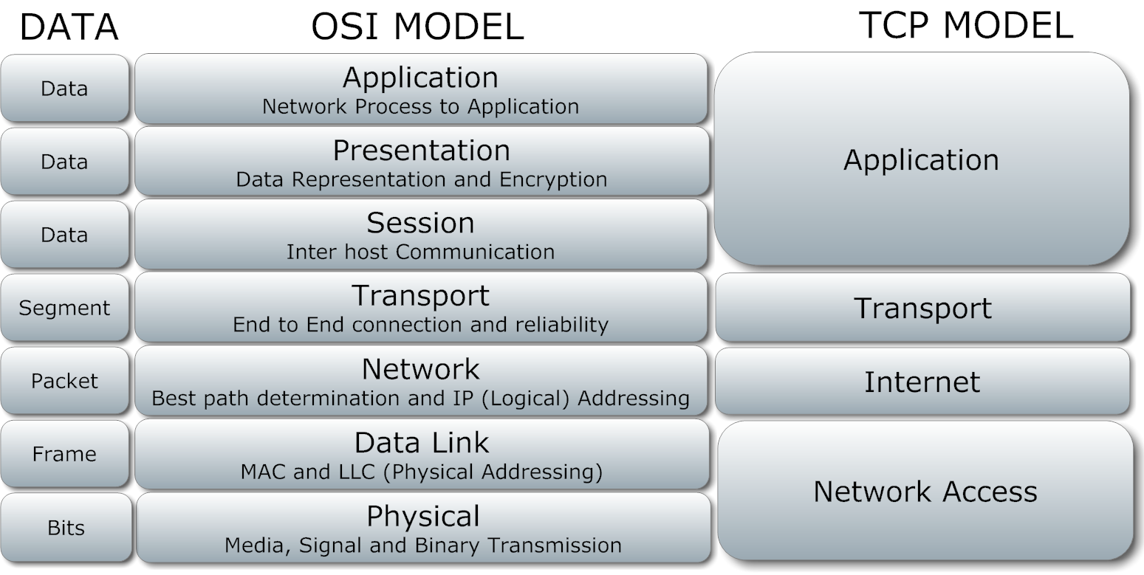
The OSI Model And TCP Model

Slide 33
Network services

Slide 34
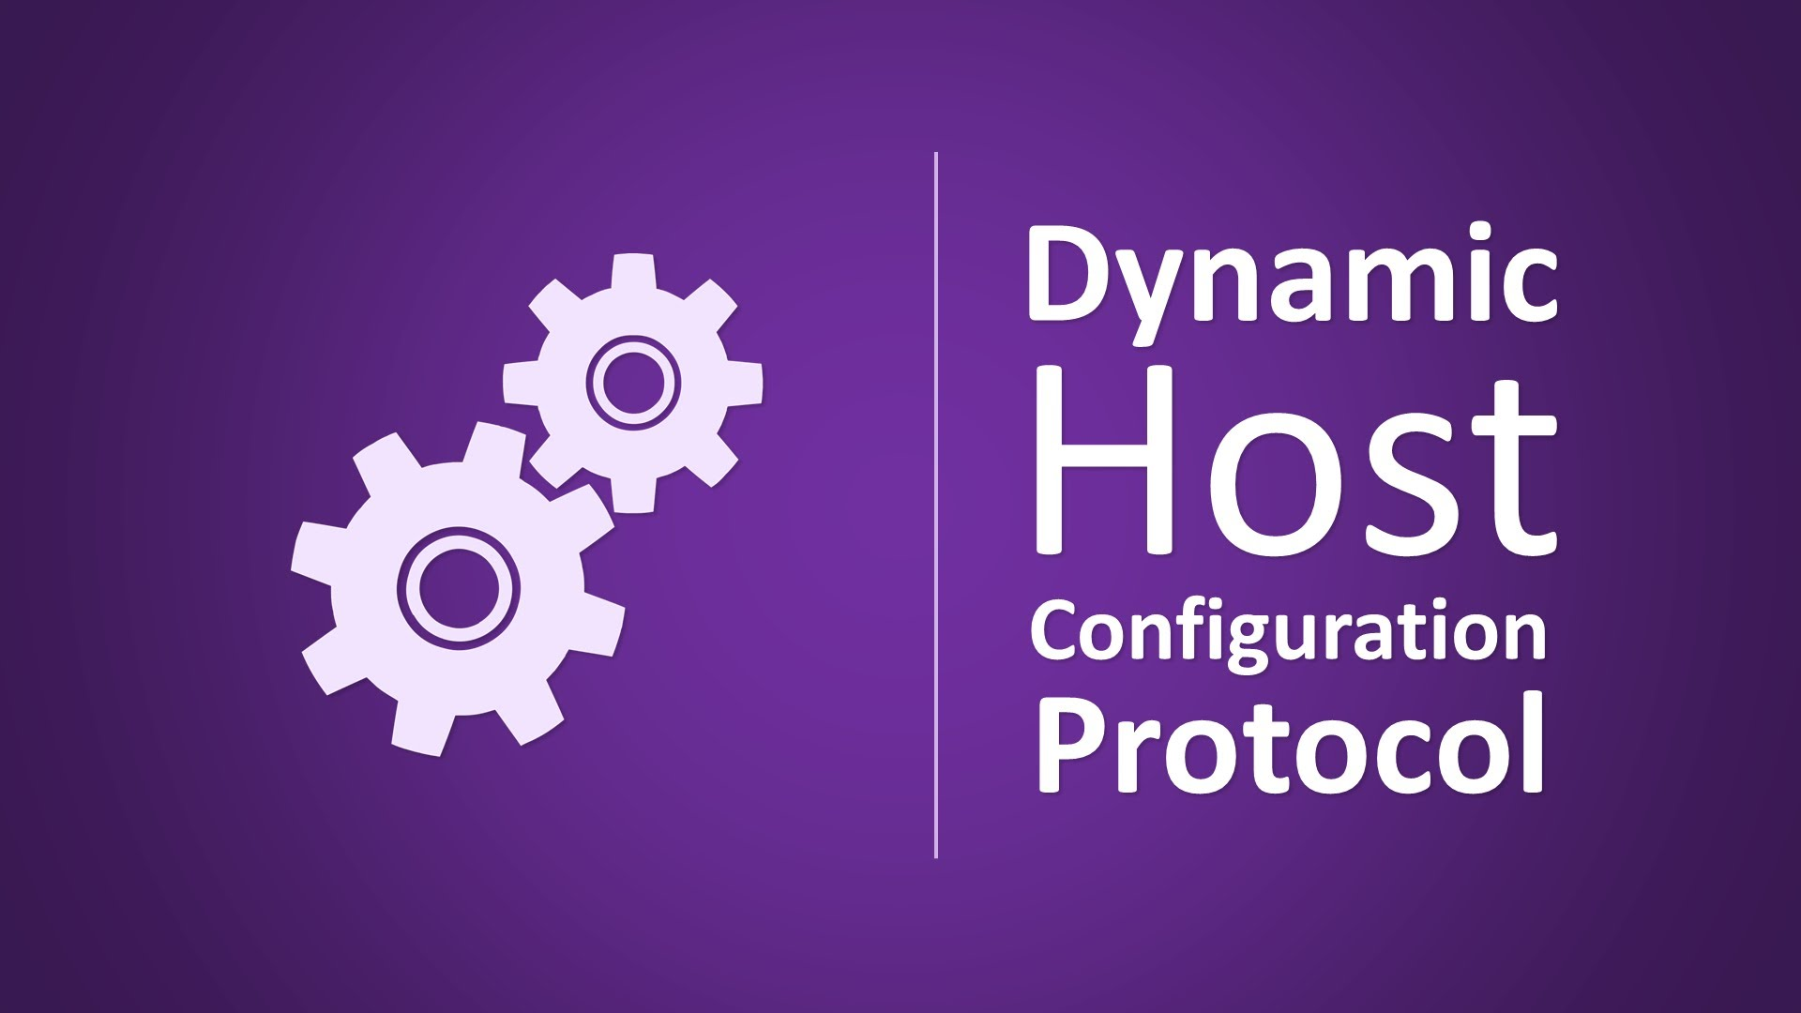
DHCP
What is DHCP?
Why we need DHCP?
IP allocation methods
Automatic
Dynamic
Manual

Slide 35
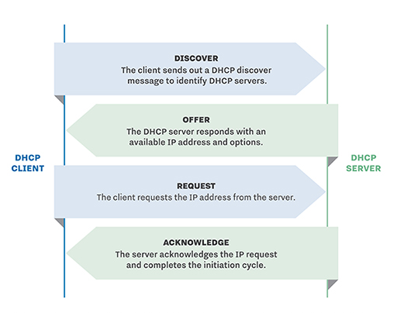
DHCP Process

Slide 36
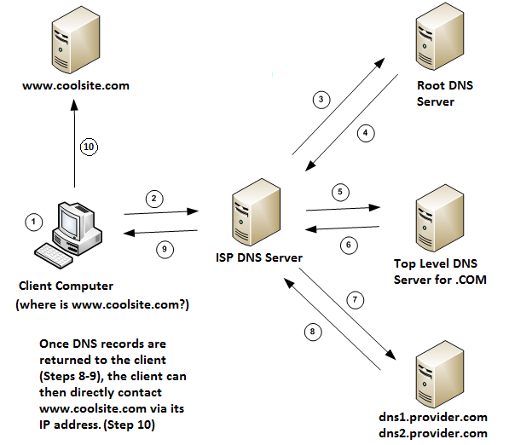
DNS Name Resolution

Slide 37
Types of Records
Host A- Name resolution
AAAA- Name resolution (IPv6)
PTR- Name Record (IP-Name)
CNAME- Canonical name/ Alias
SRV- Service Locator
MX- Mail Exchange
TXT- Any information

Slide 38
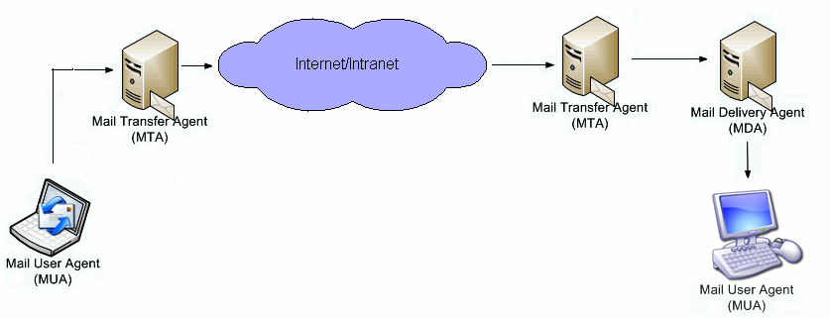
Components of mail system
MUA(Mail User Agent)
MTA(Mail Transfer Agent)
LDA(Local Delivery Agent)

Slide 39
Directory Service
LDAP(Lightweight Directory Access Protocol)
LDAP operations:
Add
Delete
Compare
Modify
Search

Slide 40
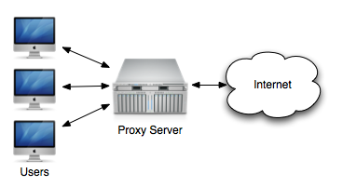
Proxy

Slide 41
Fundamentals of Database

Slide 42
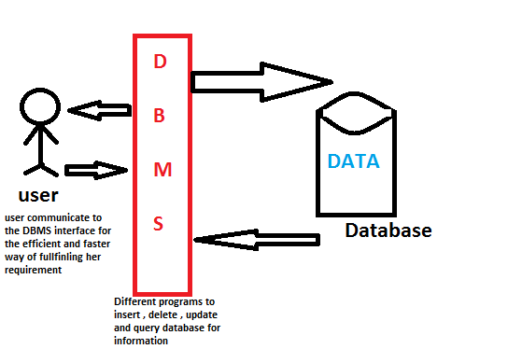
Database

Slide 43
Types Of Database & Keys
Types of Database
Flat files
Hierarchical
Network
Relational Model
Types of Keys
Candidate Key
Primary Key
Super Key
Alternate Key
Unique Key
Foreign Key

Slide 44
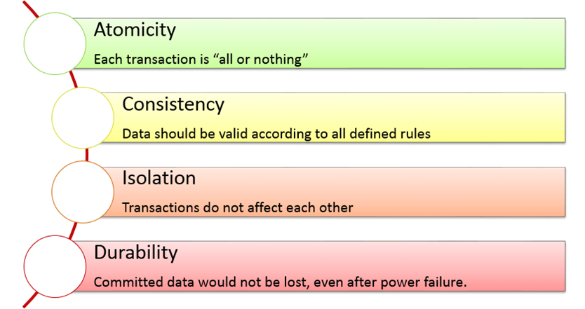
ACID Properties

Slide 45
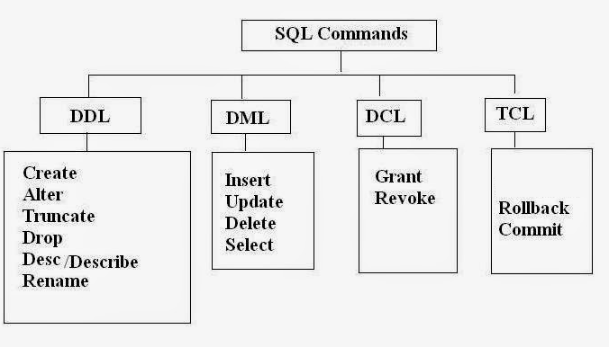
SQL

Slide 46
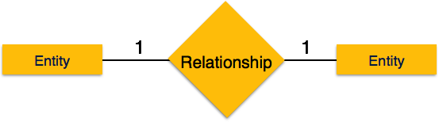
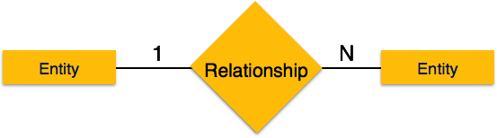
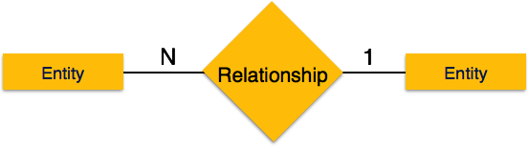

Entity Relationship Model
Types of Relationship :
One to One One to Many
Many to One Many to Many

Slide 47
Constraints
NOT NULL Constraint
DEFAULT Constraint
UNIQUE Constraint
PRIMARY Key
FOREIGN Key
CHECK Constraint

Slide 48
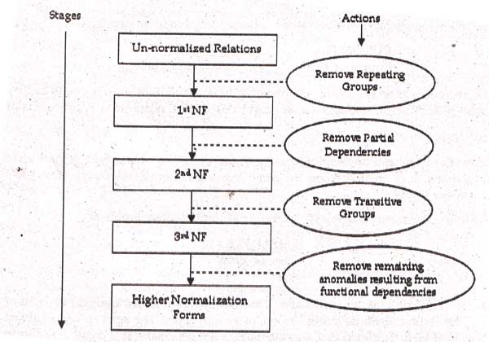
Normalization

Slide 49
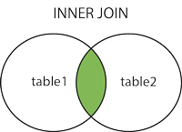
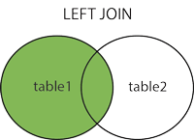
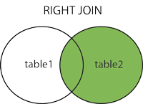
Joins

Slide 50
Fundamentals of Applications

Slide 51
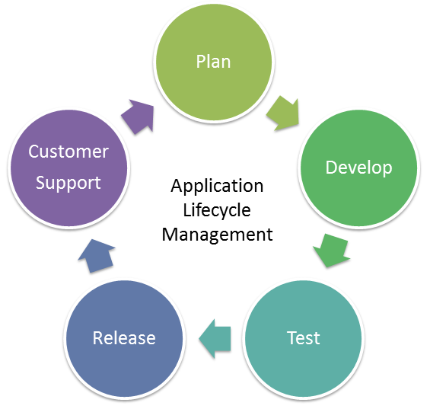
Application
Application Life Cycle
Application
Operating System
Hardware

Slide 52
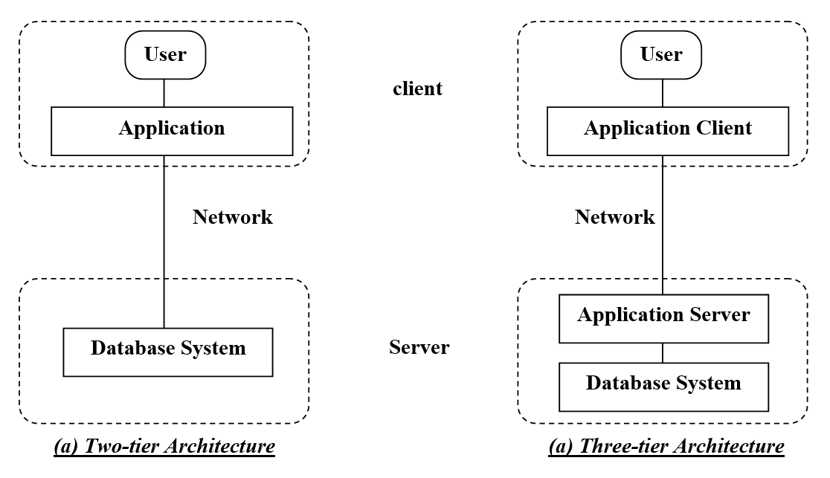
Architecture

Slide 53

Application Programming Interface
Basically, an API specifies how software components should interact. Additionally, APIs are used when programming graphical user interface (GUI) components.

Slide 54
Storage

Slide 55

Direct Attached Storage

Slide 56

Network Attached Storage(NAS)

Slide 57

Storage Area Network (SAN)

Slide 58





RAID Level

Slide 59





Slide 60
Thank you

